Slide 1

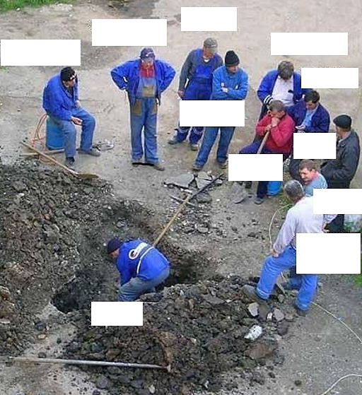

Nebraska Knights of Columbus
Financial Secretary
Workshop
Mitch O’Neill
DD 24
And Former
State FS Co-Coordinator
Chairman
O Guard
Recorder
Chancellor
DGK
Trustee 3
Treasurer
I Guard
Nice to know
All links are active.
Download the .pdf
copy from the NE website
GK
Trustee
2
Trustee
1
FS

Slide 2


Plan of Instruction
What is a Financial Secretary?
Fraternal Excellence Guide
Officers Online
Member Management/Member Billing
FAQs
Forms and Programs
Supreme/State Assessments
Audits
Affiliate Membership Initiative
Printing Cards
IRS Form 990
Other Tips

Slide 3
What is a Financial Secretary?
Assists in Managing the Council Administration
Collects Dues and Other Monies Brought in
Creates Vouchers to Spend Council Funds
Initiates Retention Actions
Order Supplies w/ Grand Knight
Complete and Submit IRS Form 990
Interface with Insurance Agency
Serves as Accountant of the Council (Ref: Officer Desk Reference: Financial Issues)
Bonded by Supreme
Appointed (not Elected) for 3 Years
Continuity When There is Turnover
Keeper of the Council Seal
Keeper of the Membership Roll
Constitutional Roll and Day-to-Day Management
Along with Treasurer and GK provides Financial Transparence

Slide 4
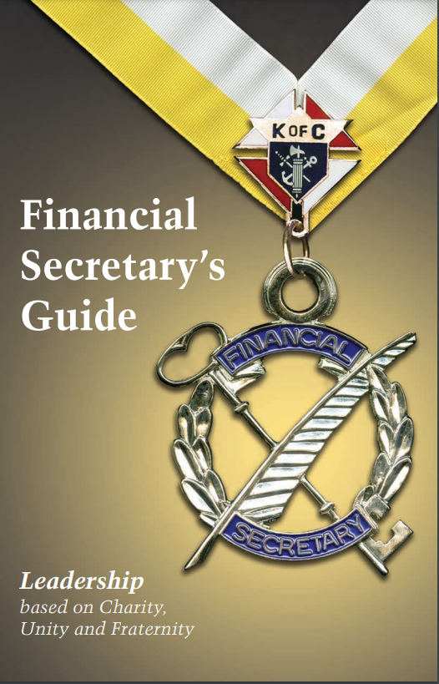
What You Are Not…
An Elected Member of Your Council
Awards Monitor
Program Director
Membership Chairman
Retention Chairman
But…They Can’t Do Their Job Without You Doing Yours

Slide 5
Fraternal Excellence Guide
One stop for all GK, FS and DD responsibilities
Published May 1st, 2025
Essentially everything we will talk about today is in this document
Your first stop for any FS questions
You will receive one in the mail in June
  Why wait? Get your digital copy now
  Give to GK, DGK, Treasurer, Trustees, Directors
  Walk through
  https://www.kofc.org/en/resources/for-members/11619-fraternal-excellence-guide.pdf

Slide 6
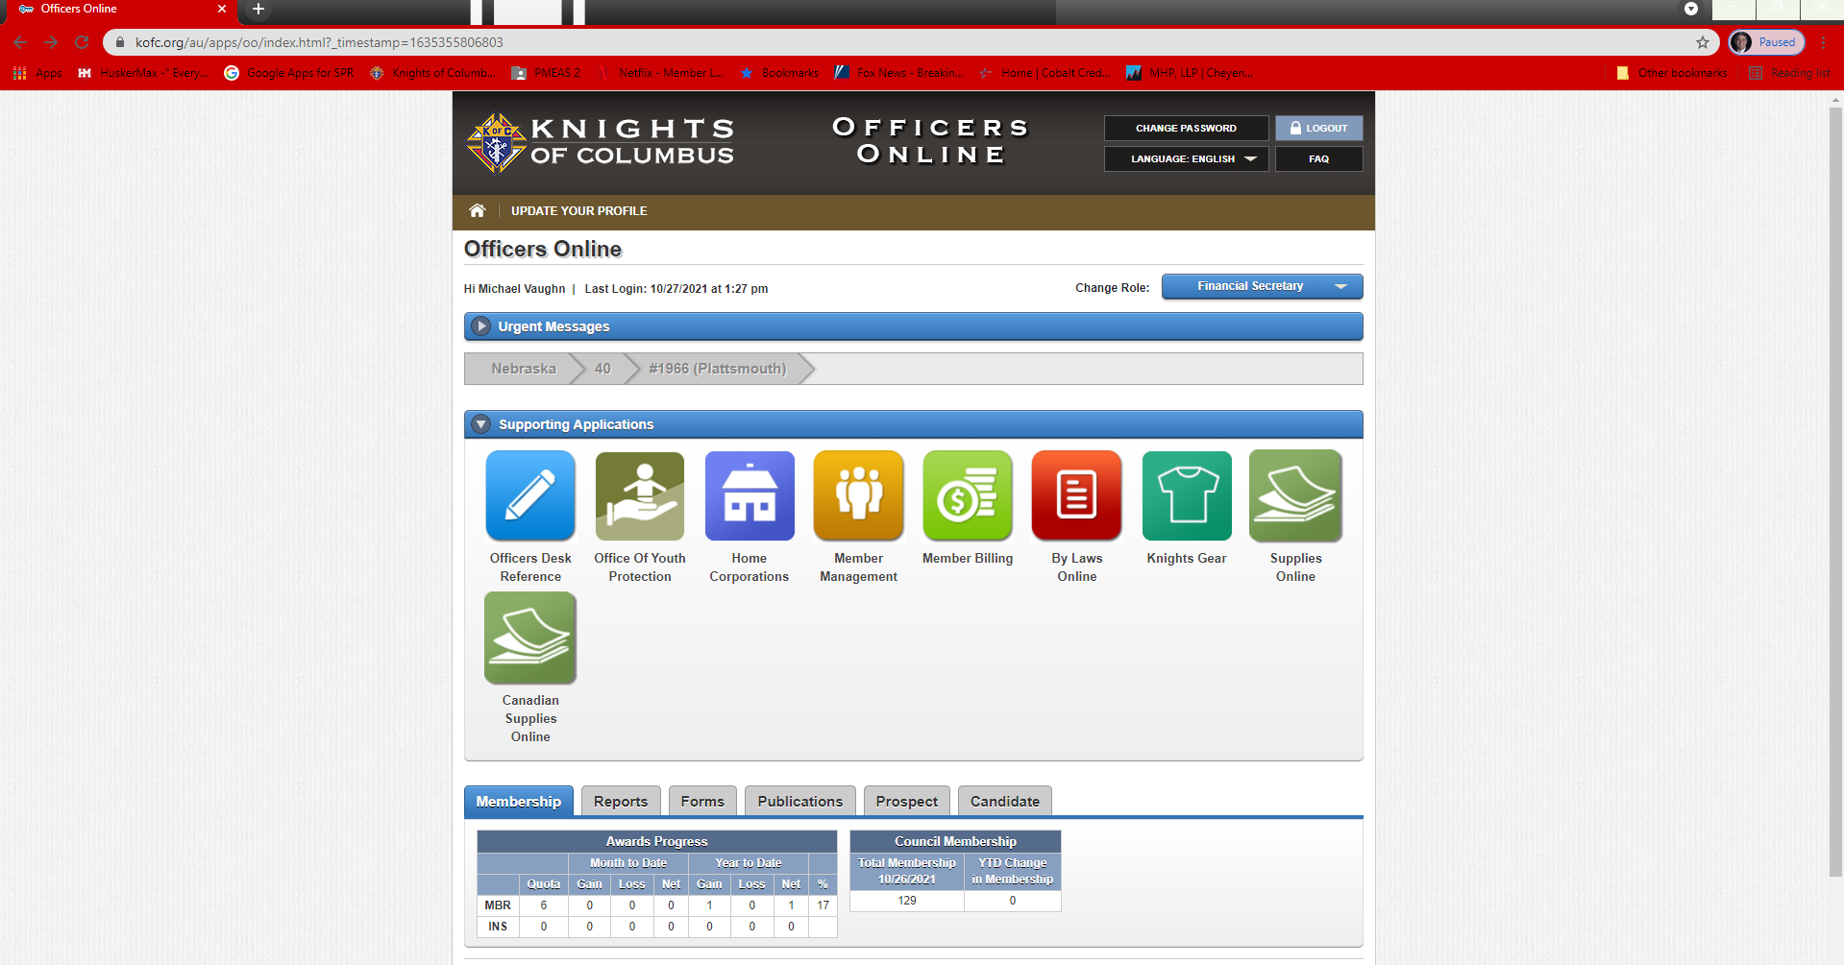
Member Management - Officer Online
Nice to Know: Some
members have
multiple roles
Only approved
officers with log-in
privileges have
access to this page
Prospect: Someone
who joined through
the supreme portal
and is eligible to
join your Council
Nice to Know: FS/FC
are the only members
to have full access to
council/assembly
information
Candidate: Latest
way to add a
new members, transfers
and readmits

Slide 7
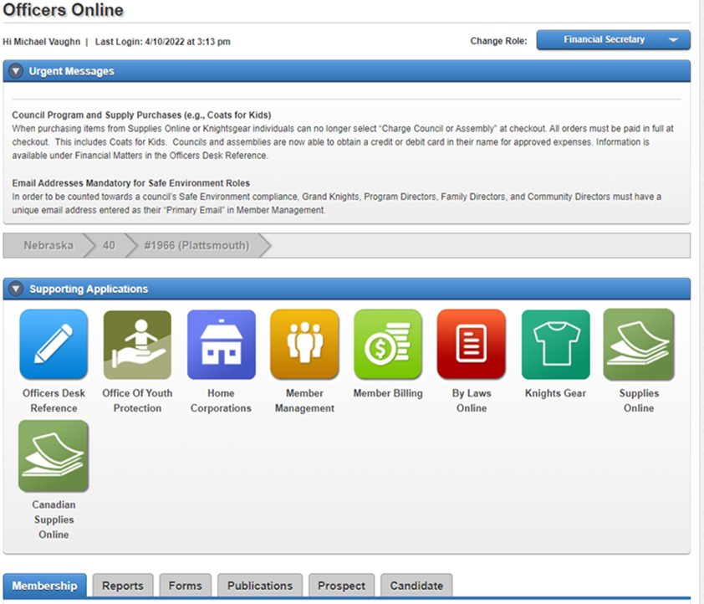
Officers Desk Reference
Definitive Guidance on the Interpretation of the Constitution and Laws of the Order…Repository of Information
One Stop Shop for Virtually All Questions
FSs and FCs Should Pay Particular Attention to the Sections on Membership Issues and Financial Issues
  Major Clarification on Chain of Custody and Officer Responsibility
  Peruse all Sections From Time to Time
PayPal, Square, Debit Cards, etc. All Have Guidance and Requirements

Slide 8
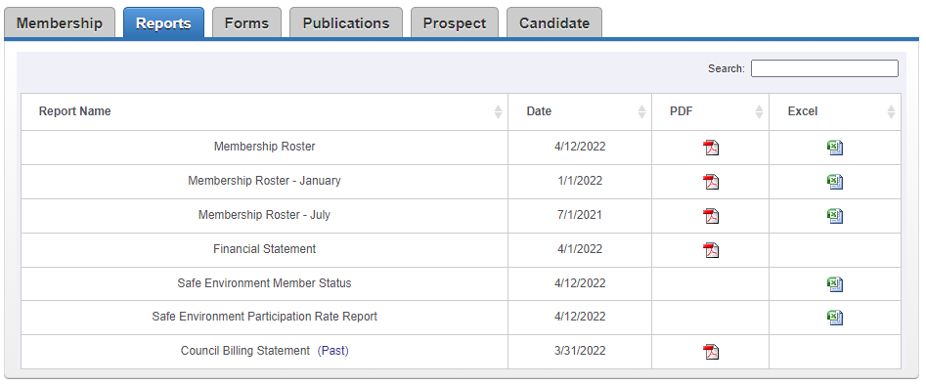

Council Reports
Nice to Know: Rosters are updated weekly
Nice to Know: Hover then click on (past) to view previous
18 months of Council Statements

Slide 9
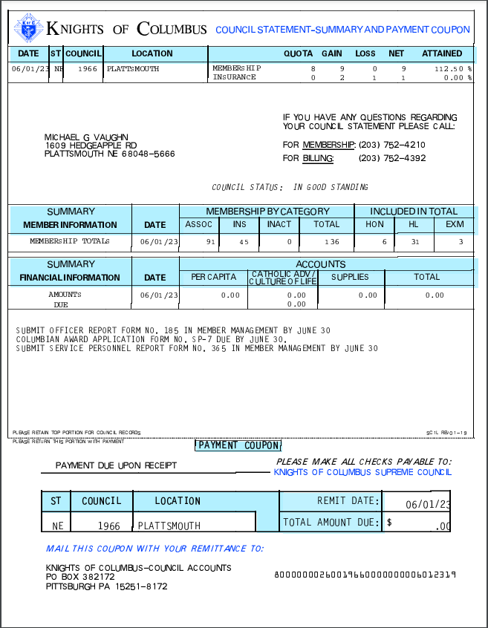
Council Statement
Ready by the first of the month
Retained for 18 months (on Website)
Provides membership Info
Provides Supreme financial Info
Status of required forms
Must be able to log into Officers Online
Payment coupon to remit Per Capita,
Catholic Advertising, and Culture of Life

Slide 10
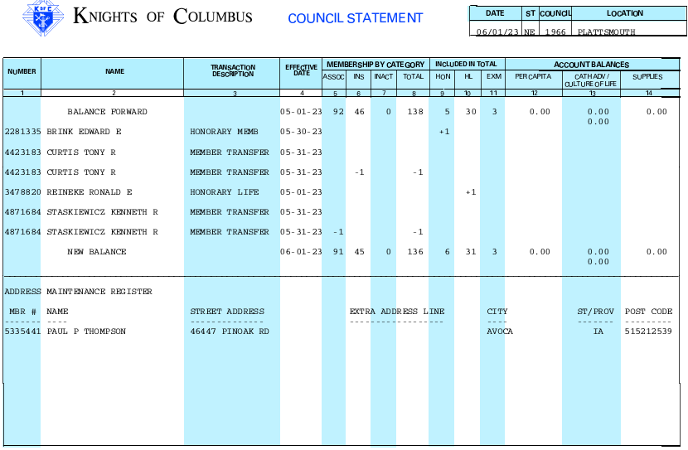
Council Statement (Continue)
Page 3 contains
membership
updates
Nice to Know: Honorary and Honorary
Life status is updated automatically
and ceremonial cards are produced
and sent to FS for presentation

Slide 11
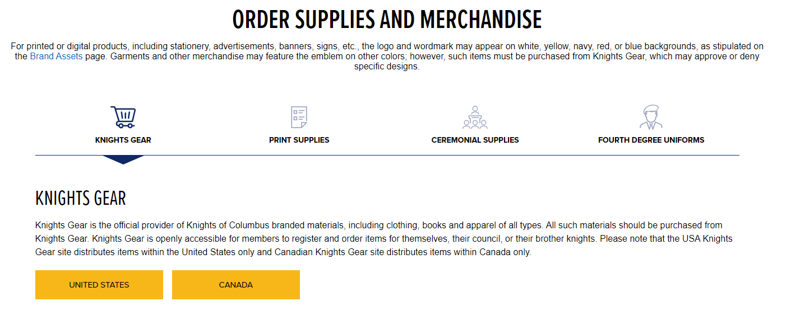
Navigating Supplies
or
Ctrl-Click this Link
Order Supplies | Knights of Columbus

Slide 12

Member Management/Member Billing
Tracks Membership
Dynamic Data Base
  Scalable for Your Needs
Official Way of Tracking/Facilitate Movement of Funds
Initiates, Collects, and Tracks Annual Dues and Assessments
Produces Membership Cards
Provides Documentation for Audit
The Order’s accounting system and member database

Slide 13
Member Management/Member Billing (Cont)
System is Secure (HTTPS)
System will not “Balance your Books”
  Still Need an active Treasurer
Access through Officers Online
Divided into three main sections
  Council Activities
  Member Management
  Member Billing
All Councils Should Be Using Member Management

Slide 14
Adding Members
Form 100 | Candidate’s Tab | Join through Supreme Website
Paper Copy | Officer Online | New member Selects “Join” Button
Scan and Email | Online | Online
New Members | New Members | New Member Becomes a Prospect if Council Identified
Can Transfer and React Members | Can Transfer and React Members | Cannot Transfer or Reactivate
Retain Form 100 for Records | Produce and Retain Paper Form 100 | No Paper Form 100 Required
1st, 2nd and 3rd Degree Date is date CUF taken | 1st, 2nd and 3rd Degree Date is Date CUF Taken | 1st Degree Date is date joined 2nd and 3rd Degree Dates CUF Taken
New Members and Reactivated Member - Credit to Council | New Members and Reactivated Member - Credit to Council | Membership Credit to Council (When Transferred) and Agent
Dues Paid to Council | Dues Pay to Council | Dues paid to Supreme Until Transfer
Can Take Several Weeks to Process | Near Instant for New. 2-3 days for Transfers and Reactivations | Near Instant

Slide 15
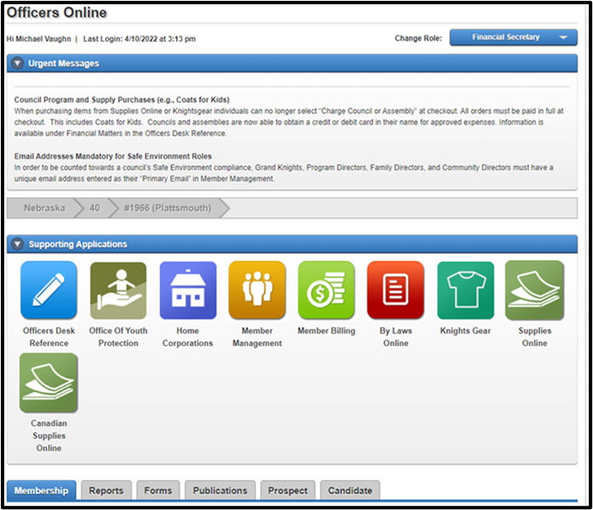
Member Management/Member Billing
Council ADMINISTRATION Section
Notifies Hierarchy Who in Charge
Tracks Council Officers and Committee Leads
Provides Rates
Updates Officers (185) and Committee
Leads (365) After Elections
Updates Go Directly to Supreme
Provide a .PDF Update to State Executive Secretary
Demo
  Nice to Know: Both Forms are due by June 30th

Slide 16
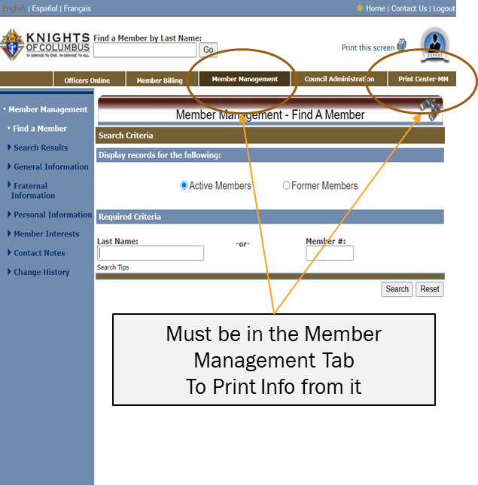
Member Management/Member Billing
Member Management Section
Manages all Council Personnel
Up to You to Determine Detail
  For Example; Birthdays, Spouse Info, etc.
  Print Section Allows for Specialized Lists
Divided Into:
  Fraternal Information
  Personal Information
  Public Information
Prints Only Items Related to Member Management
Demo

Slide 17
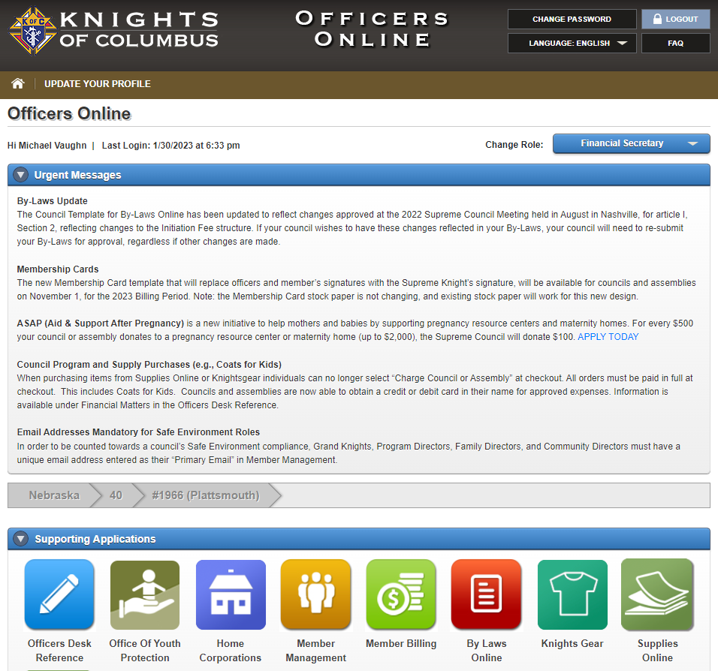
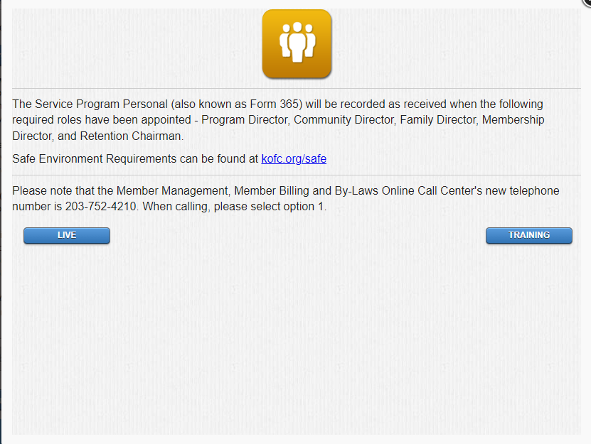
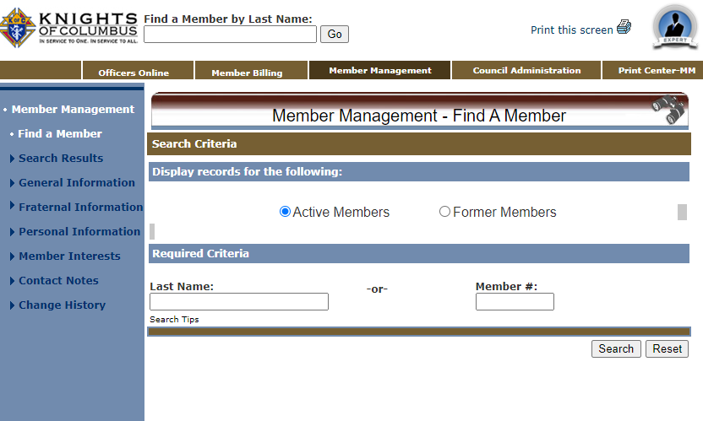
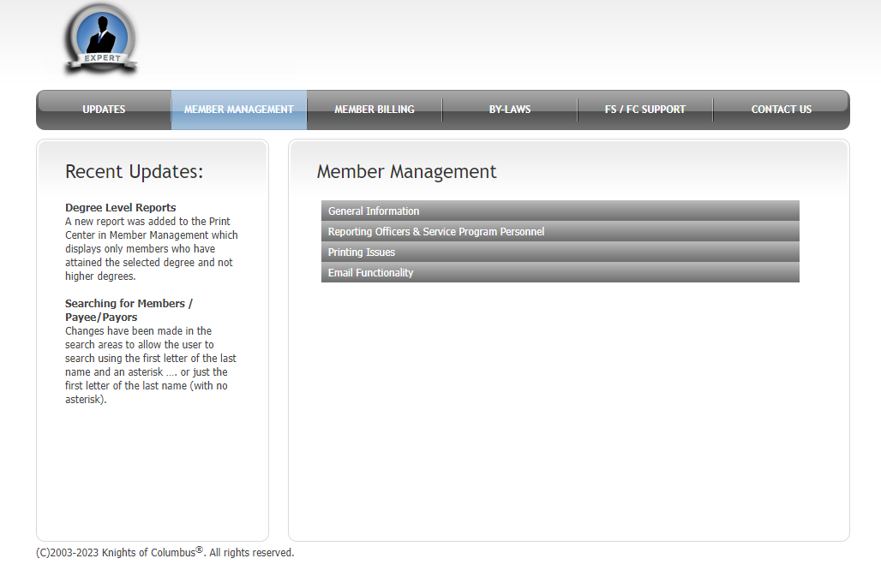
Member Management “Expert”
Press
“Expert”
Button

Slide 18
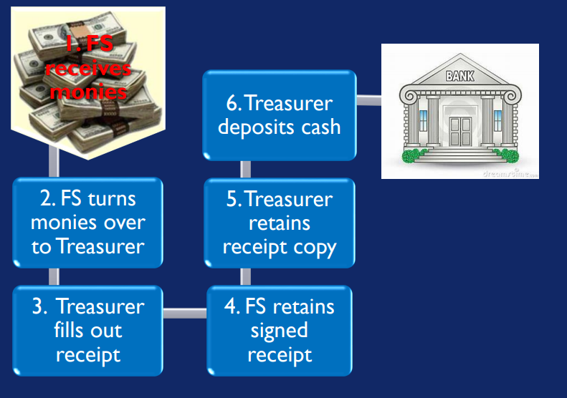
Receipts
Chain of Custody
FS Gives Receipt as He Takes Custody of Funds. Maintains in His Records
FS Hands Off Funds to Treas. Treas. Gives Receipt to FS
3) FS Brings Receipt to GK @ Next
mtg
4) Treasurer Brings Proof of Deposit
info to GK @ Next Mtg
5) GK Reports to Council by Reading
Receipt(s) and Proof of Deposit(s)
at the Meeting Ensuring They are
identical
Accounting for Funds
FS Enters Receipts into MB
FS Presents Receipts to
Treas. and Both Sign
3) FS Retains Signed Copy
And Treas. Retains a
Copy
4) Retained for Audit

Slide 19
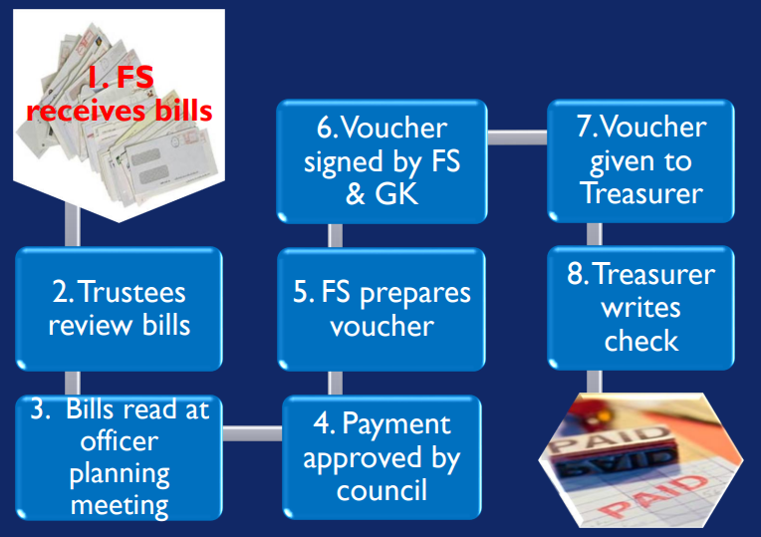
Vouchers
(AKA: Order on Treasurer or Warrant Voucher)
Trustees Must Review
All Bills
Nice to know: Checks are
Signed by the Treasurer: They
Do Not Need to be Countersigned
by the GK
(Ref: Officer Desk Reference –
Financial Issues
No check is to be written without a voucher signed by the FS and Countersigned by the GK

Slide 20
Forms and Programs
Who is Responsible?
Most are Electronic: Scan/Email or Mail
Due Dates
  Identified in Knightline, Council Statements, and Websites
What about charitable events like One Rose, One Life, BAM, RSVP, etc.?
Forms: SP-7, Audits, 10784 etc.

Slide 21
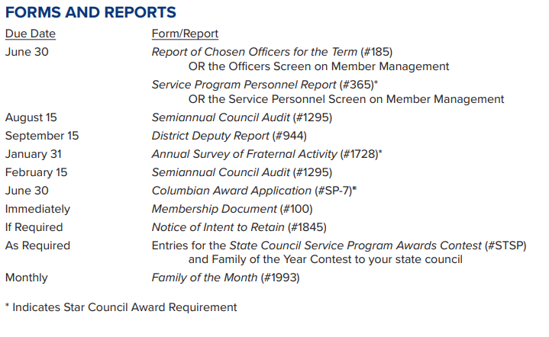
Supreme Due Dates
Nice to know: Supreme
recommends Officers Screen
or Service Screen on Member
Management. “Fill and Forget”
Nice to know: NE Jurisdiction
recommends AMI only. Intent
to retain is the old process we
Do not recommend.
Councils should use
temporary billing procedures
outlined In Fraternal
Excellence Guide #11619
pages 32 and 33
Important! Forms 185, 365, 1295, and 1728 are mandatory and always required!

Slide 22
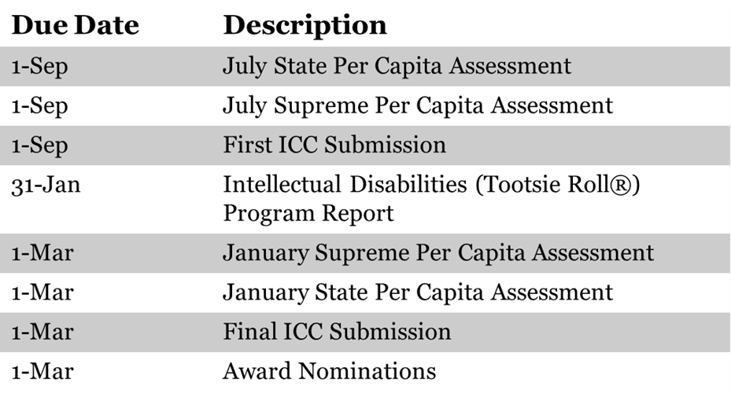
State Due Dates

Slide 23
Supreme and State Assessments
(Due Upon Receipt)

Slide 24

Audit
Audit is Required Semi-Annually
Conducted by Grand Knight and the Trustees
Requires Close Coordination Between Auditors, Treasurer, and FS
FS needs to Produce the Report of Receipts and Report of Vouchers
Treasurer Produces His Ledger to the Auditors
Documented and Signed on Audit Form 1295
Completed audit is Forwarded to Supreme, DD and Executive Secretary (Mike Vaughn)
  He Maintains for the State Deputy
Nice to know: Process
explained in Fraternal
Excellence Guide
pages 18 to 20.
Supreme Training Video:
Audit Training Video

Slide 25
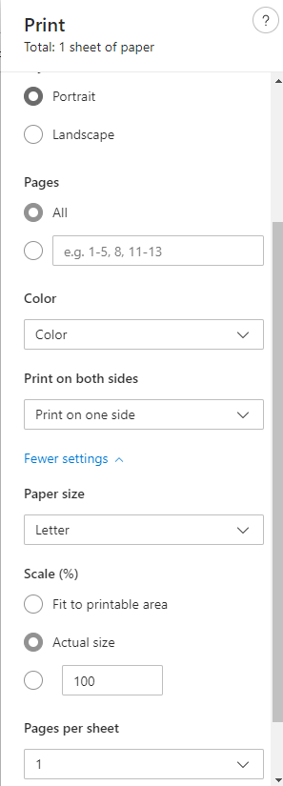
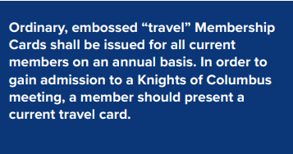
Printing Membership Cards
Nice to Know: Membership Card
(#4817) stock paper can be
ordered through Supplies Online.
(Cards come eight to a sheet
with 25 sheets to a package,
for a total of 200 cards.)
Done in Member Billing
Save the downloaded PDF file
to your PC and close browser
Print from the downloaded PDF
file saved to your PC
  Printing from browser can select wrong scale
Ensure “Actual Size” or “100%” Scale
is selected
    Some variations in printers
    trial and error
Emboss cards IAW page 32-35 of
Fraternal Excellence Guide
Always Do a Practice Run!

Slide 26
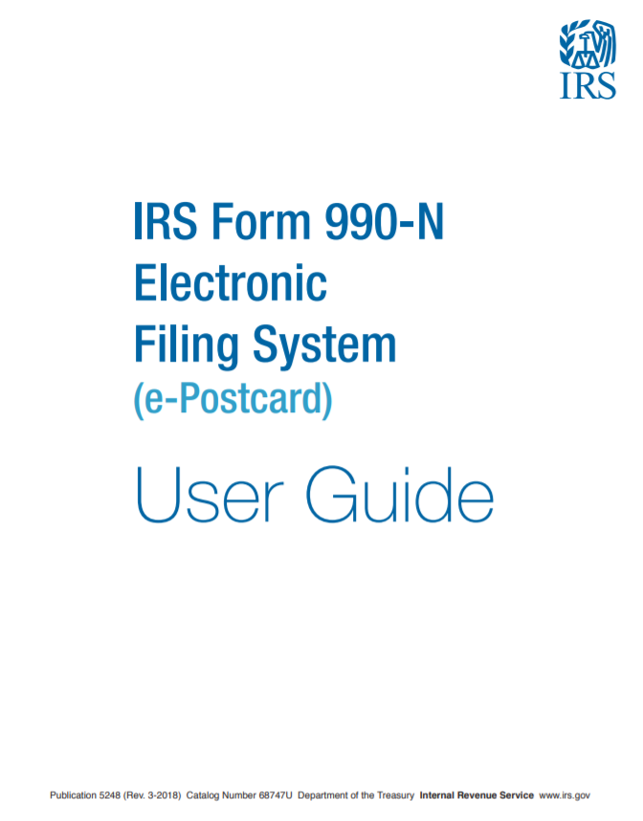
IRS Form 990
Required Annually - Cannot Skip a Year
Plenty of Notice
990N Electronic Post Card
  Under $50,000 in Gross Revenues
990-EZ: $50K to $200K
Form 990: > $200K
Failure to Comply: Loss of Tax-Exempt Status and Revoking of EIN
Nice to know:
Supreme recommends
using an accountant
if you are over
$50K in revenue.
https://www.irs.gov/charities-non-profits/annual-electronic-filing-requirement-for-small-exempt-organizations-form-990-n-e-postcard

Slide 27
Suspension: Failure to Pay Dues
Non-AMI Councils
Still Available But Going Away. Not Recommended
Reference
Fraternal
Excellence Guide
Pages 30-31
Ensure you sent the proper Dues Notices
1st Notice, 2nd Notice, and Knight Alert
Process Intent to Retain paperwork
    Mail copy to member and email to Supreme
    Supreme and State will spend the next 60 days attempting to convince the member to remain a member and pay their dues
After 60 days but no Later than 90 Days, Submit Form 100 for Suspension.
    If Supreme Receives the Suspension Form 100 After the 90th Day From the Intent to Retain Paperwork, You Will Need to Start Over with a New Intent to Retain Memo
If Insurance Member, the Suspended Member will Remain on Your Rolls
Nice to know:
Need to
find out why

Slide 28
AFFILIATE MEMBERSHIP INITIATIVE Participating Councils
Withdraw a Member who no Longer Wants to be a Knight
Follow Temporary Billing Procedures Found in Fraternal Excellence Guide Page 32-33
If an AMI Member Transfer Back to your Council, do not Charge Dues in the Arrears
https://nebraskakofc.org/membership/recruiting-resources.html
Questions: Contact Supreme at affiliate@koc.org or 203-752-4270
Nice to know:
Process members who
meet the requirements
for designation as Affiliate
Members. Lists of these
members should be submitted
through a council’s district
deputy and received by the
Supreme Council no later than
the last day of the billing cycle.
Nice to know:
Suspension transactions under
AMI are reserved for Summary
Suspension for Cause and
Board Action

Slide 29
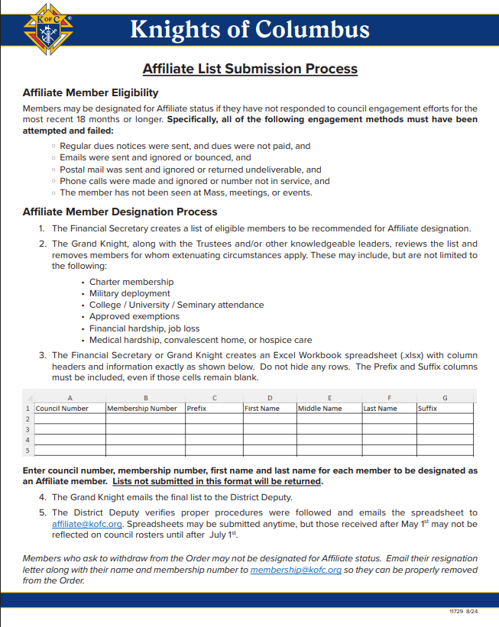
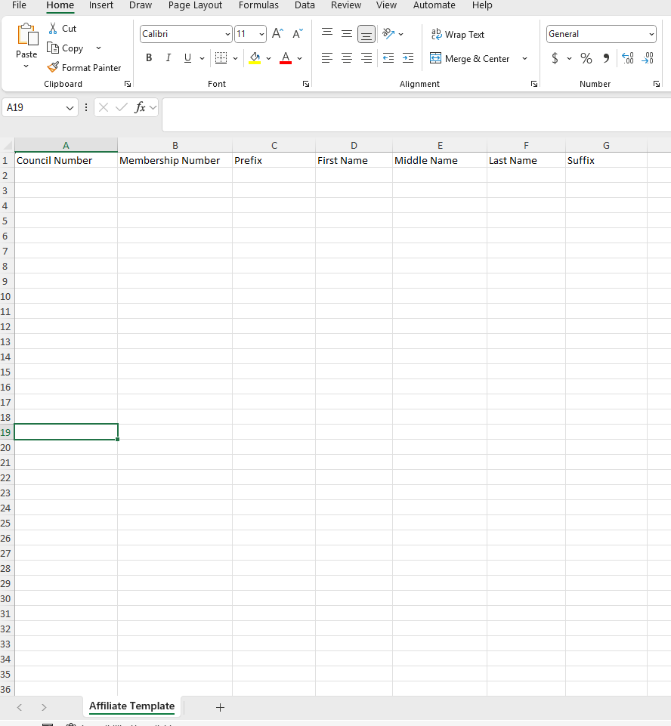
AMI Submission Process Form 11729
Template

Slide 30
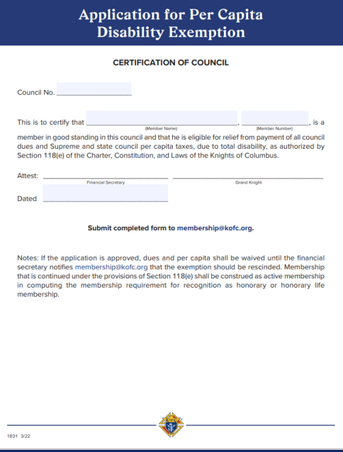
Disability Exemption (#1831)
Relief From Dues and Per Capita
GK and FS Attestation Only
No Doctor’s Report
No Annual Recertification
Forms Section of “For Members”

Slide 31
Fraternal Leader Advisory
Sent from Supreme Directly to Council Leadership (and Others)
Provides Breaking News, Reminders, Resources and Recommendations
Emailed Directly to You…Not Getting…Verify Email and Ensure it is Not Going to Junk Mail
https://www.kofc.org/en/news-room/fraternal-leader-advisory/index.html
All FSs and FCs Must Receive

Slide 32

Other Tips
Council Bi-Laws
  Advocate is Responsible
  Update Periodically: Red Tab on Officers Online
FS is 5th in Line to Conduct a Business Meeting
  IAW Sec 126/136 of KofC Constitution
Work with the Insurance Agent
  His Eyes and Ears to the Council
Safe Environment Training – MANDATORY!!!
Budget
  Section 122(B) – the $500.00 rule
  Annual Budgets Satisfy the $500 Rule
Nice to know:
By Laws need updating when
the GK or Secretary Recorder is
Replaced.
Nice to know:
Order to conduct a meeting
GK
DGK
Chancellor
Recorder
Financial Secretary
Nice to know:
Safe Environment Participants
Grand Knight
Program Director
Community Director
Family Director

Slide 33
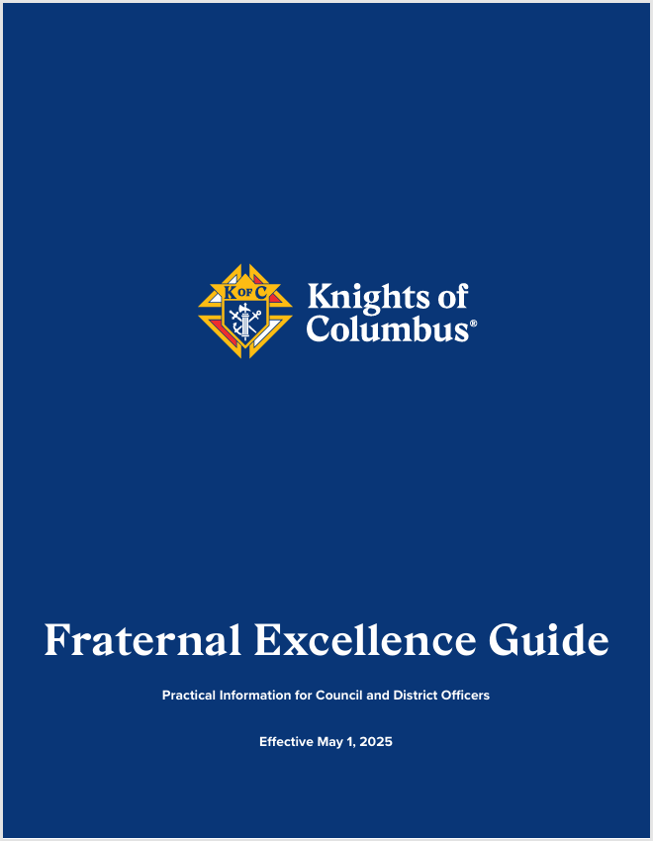
Resources
Fraternal Excellence Guide (11619)
https://www.kofc.org/en/resources/for-members/11619-fraternal-
excellence-guide.pdf
FRATERNAL LEADER ADVISORY
https://www.kofc.org/en/news-room/fraternal-leader-advisory/index.html
Fraternal Video Library
https://www.kofc.org/en/videos/fraternal-training-library.html
State Financial Secretary Resources
https://nebraskakofc.org/resources/financial-secretary-resources.html

Slide 34
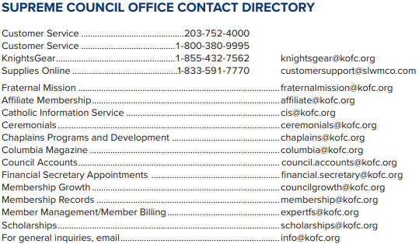
You Are Not Alone…
Nice to know:
State FS Coordinator
Chairman Joseph Kaup
Cell: 402-340-9875
Email: kaupjoseph@gmail.com

Slide 35

Nebraska Knights of Columbus
This is the Way
Questions?
Evangelize Our Family & Community

