Slide 1
Nebraska Knights of Columbus
Transferring Members to Council
Using On-Line Candidate Tab

Slide 2
Transferring on-Line
How does the “Candidate” tab work for transfers? Enter information as you would for a new member. Be sure to include his name as it appears on his membership card. When submitting the member’s information, place the date that he was voted into the council as the ‘process date’. The Supreme Council’s system will identify the member by name and date of birth to be processed separately as a transfer instead of a new member. Providing the membership number of transferring members is not needed for processing and, thus, not a field on the “Candidate” tab.
What fields are required on the candidate tab? In order to submit a member transaction via the “Candidate tab”, the following fields must be submitted: First Name, Last Name, Date of Birth, Cell Phone, Email, Address, Zip/Postal Code, City, State, and Country. Fields such as Title, Middle Initial, Suffix, Address Line 2 and Proposer are optional fields. An individual’s membership number is not required to process transferring members and, thus, not a field on the “Candidate” tab.

Slide 3
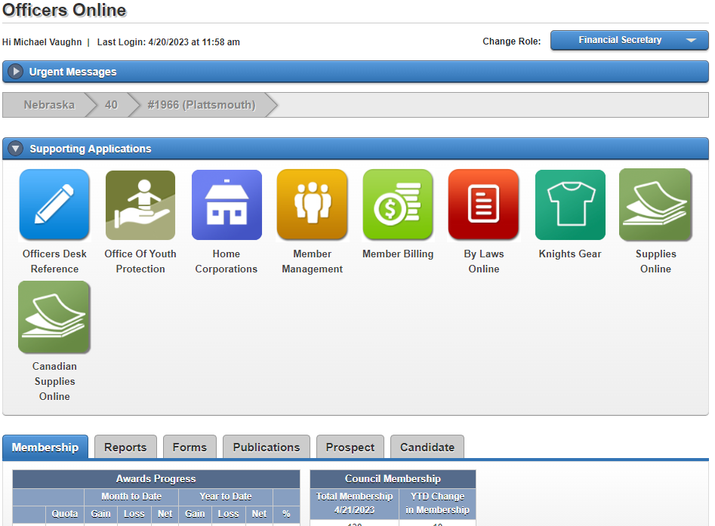
Transferring on-Line (cont)
Click Candidate Tab to Open Next Window

Slide 4
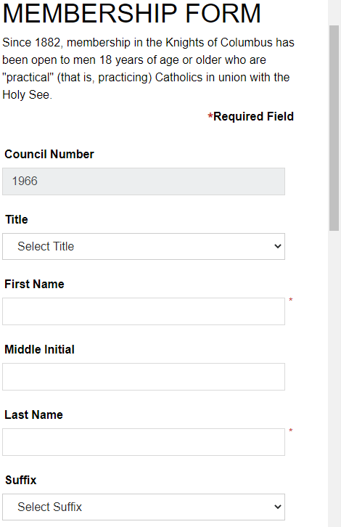
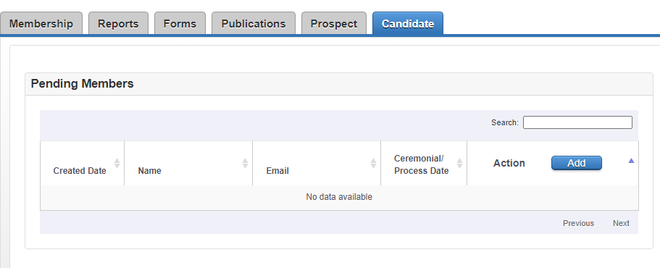
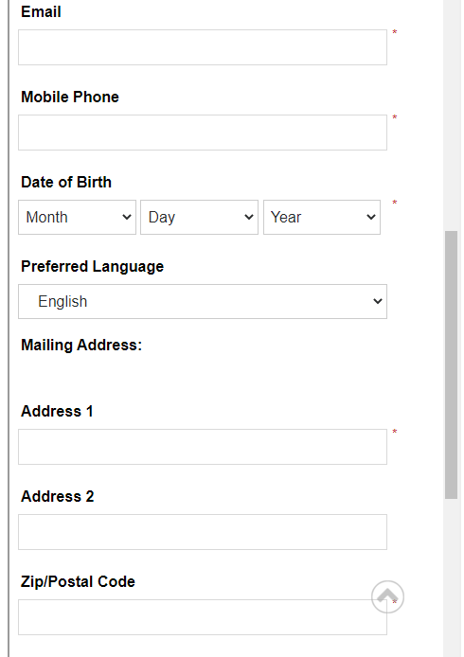
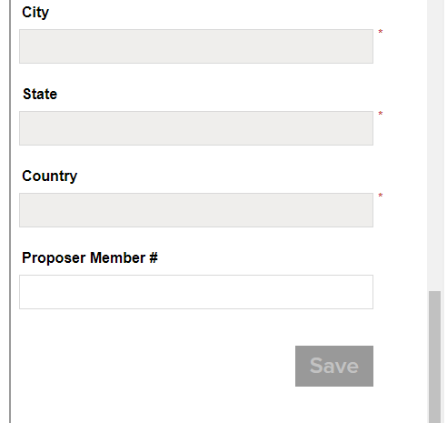
Transferring on-Line (cont)
Click “ADD” to open Membership Form
Input info as a you would a new member
Supreme will process as transfer
based on name and birthday
Be sure to click Save!

