Slide 1
Nebraska Knights of Columbus
Where to find help when for
Member Management
or Member Billing
is Driving you Crazy
So, you are the Financial Secretary
Learn the FS ways, you will

Slide 2
What is Member Management Member Billing?
The Order’s accounting system and member database
Located in the Officers Online section of the website
Member Management
Tracks all members of the Council
Allows for housekeeping actions such as change of address and email
Eliminates the need for Form 100 actions except new members, Reapplications/Readmissions and suspensions
Comprehensive data queries

Slide 3
What is Member Management Member Billing (cont)?
Member Billing:
Management of financial transactions
creates, edits and archives receipts, vouchers, assessments and adjustments;
Maintains a list of accounts and subaccounts, payee/payor lists and council defined sub-classes for billing (military, students, etc;),
Produces billing notices; and manage payments received from members.
The Member Billing application works in conjunction with the Member Management application

Slide 4
Help or “Expert” Function
MM and MB each contains its own Help section
Contains useful information in setup and little
used processes like annual and other assessments
Provides some troubleshooting actions for common problems
Provides information recent updates
Some overlap between the two (i.e. Email Functionality)

Slide 5
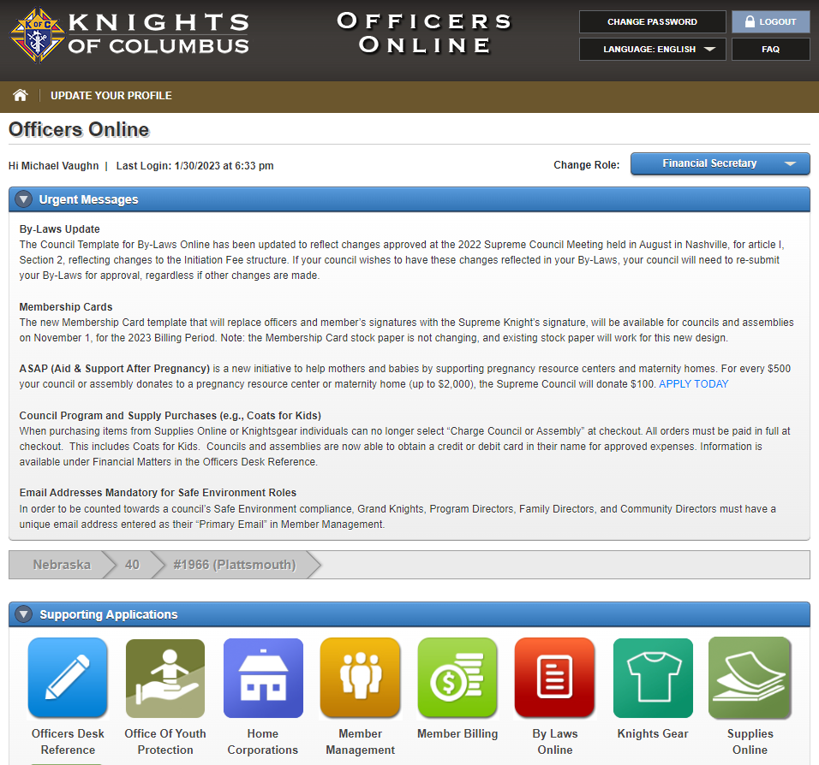
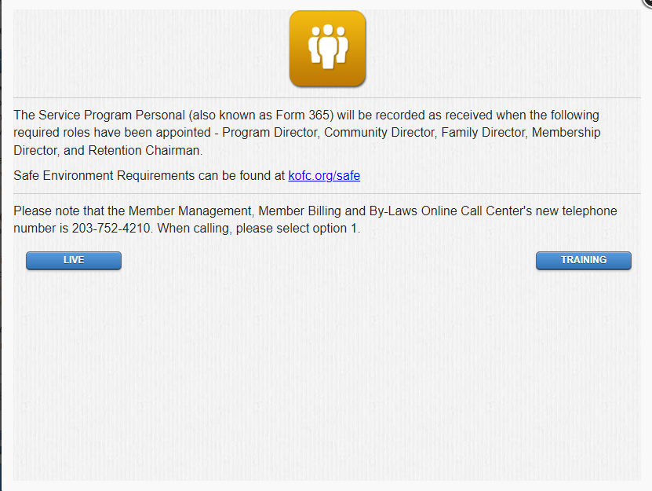
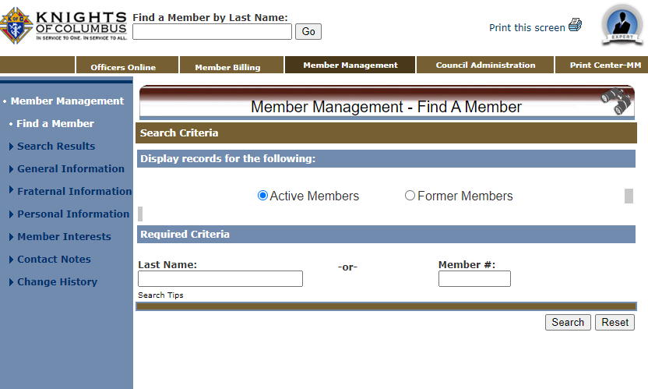
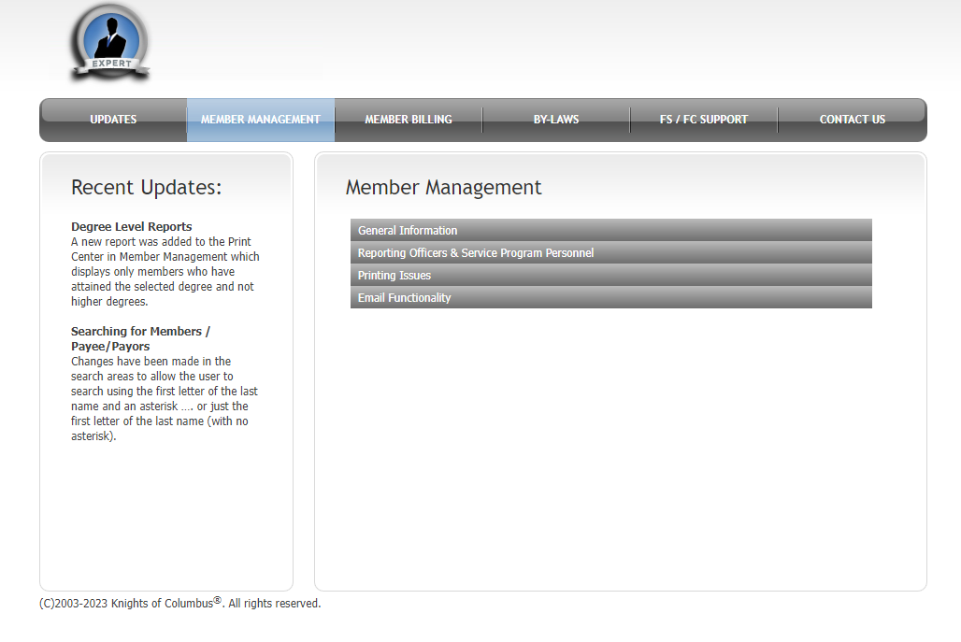
Member Management “Expert”
Press
“Expert”
Button

Slide 6
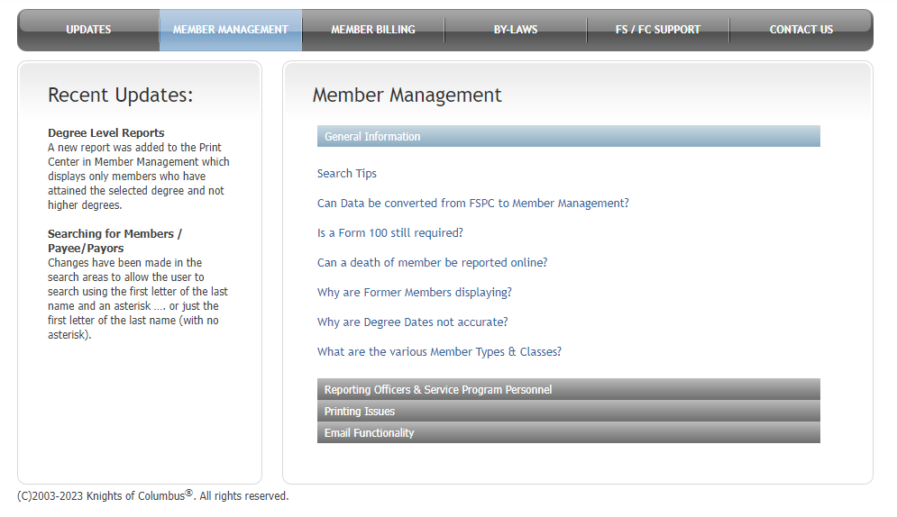
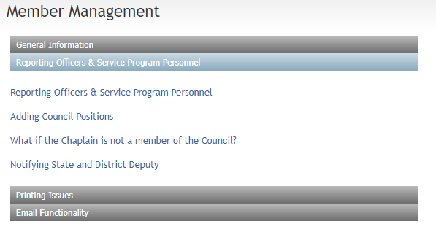
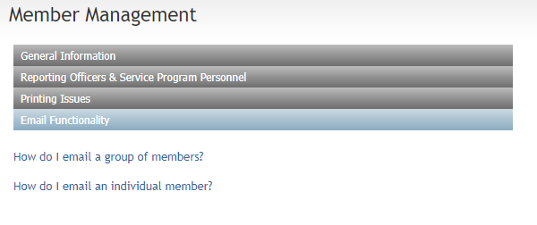
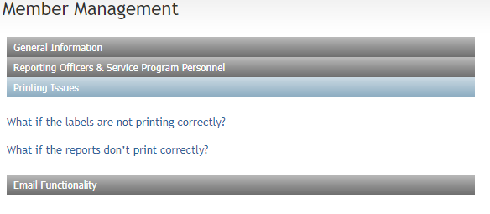
Help Areas for Member Management
How to accomplish
the 185 and 365

Slide 7
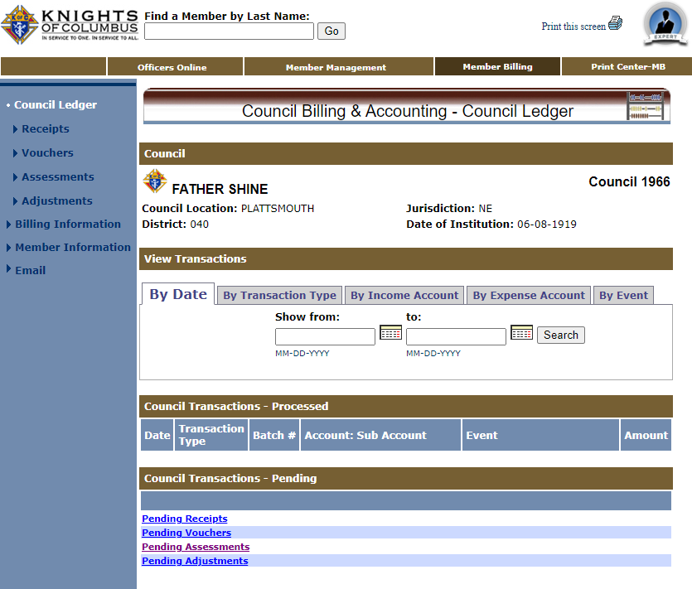
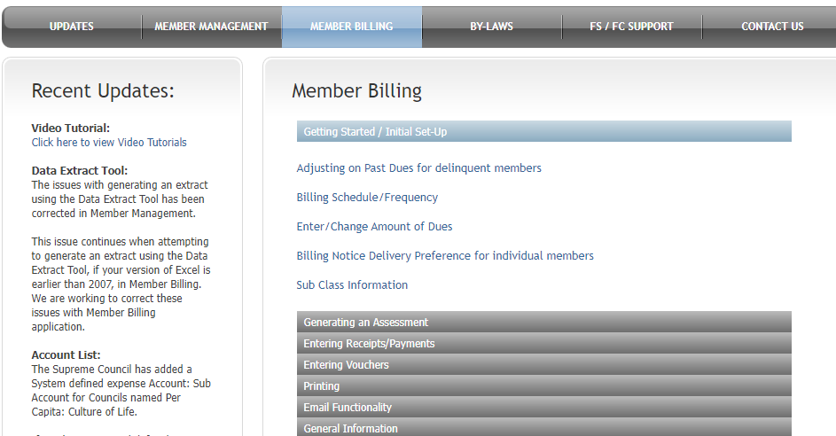
Member Billing “Expert”
Press
“Expert”
Button

Slide 8
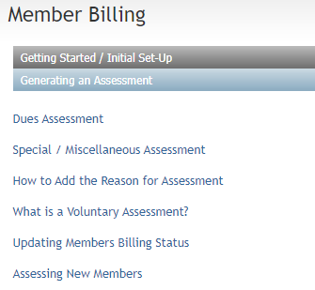
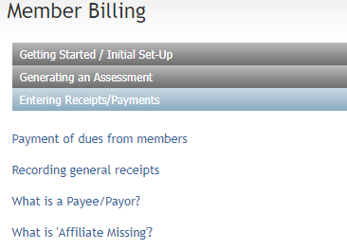
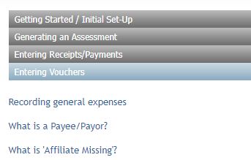
Help Areas for Member Management

Slide 9
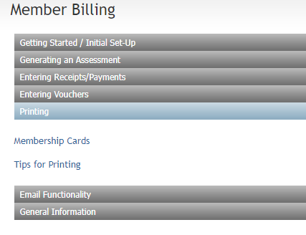
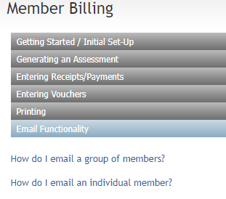
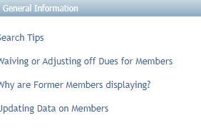
Help Areas for Member Management (Cont)

Slide 10
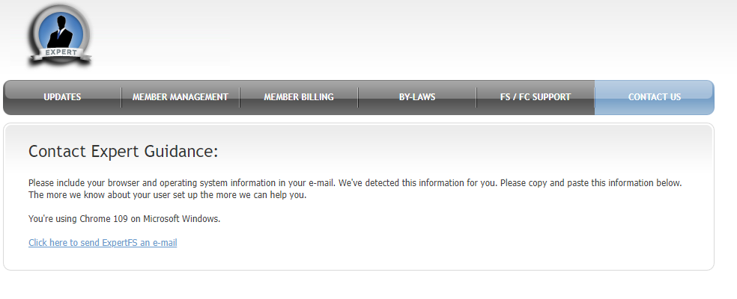
When all Else Fails…
When you just need to talk to someone
First - FS Coordinator Chairman: Mike Vaughn, 402-297-5434, Email: Michael.vaughn@windstream.net
Second - Member Management/Member Billing, Phone: 203-752-4210, Email: expertfs@kofc.org
Third - Financial Secretary Appointments Phone:203-752-4285, Email: financial.secretary@kofc.org

