Slide 1
Nebraska Knights of Columbus
How to Submit Form 185
(186 for Assemblies) and 365

Slide 2
Member Management Council ADMINISTRATION Section (Cont)
Click on Council administration to get to the proper screen

Slide 3
Member Management Council ADMINISTRATION Section (Cont)
Form 185
Form 365
Click on Council Officers
or Service Program
Personnel

Slide 4
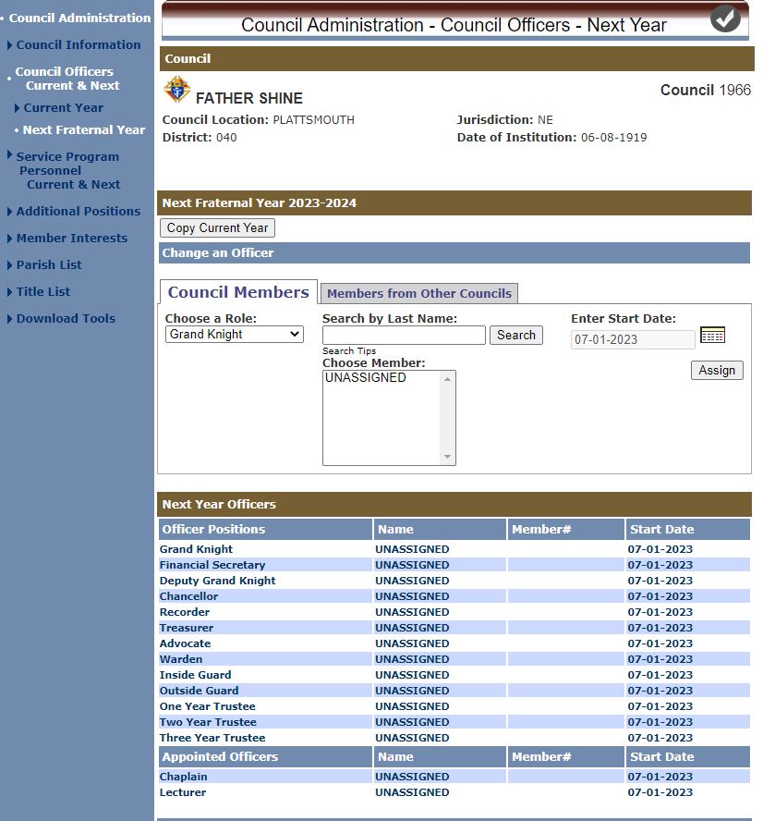
185 - Council Officers
Chose “Copy Current Year”.
You now only need to
change positions with new
officers

Slide 5
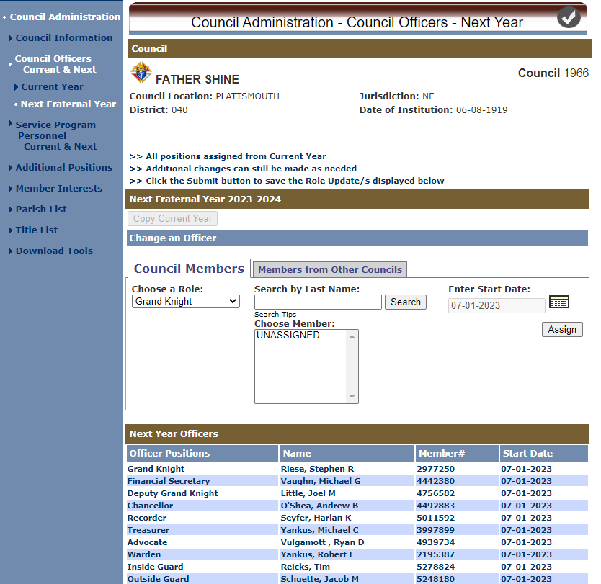
185 - Council Officers Cont)
Chose each opened position.
Search by last name and
assign date. Date defaults to
July 1st of new fiscal year
Select assign.
Repeat until you filled all
Positions.

Slide 6
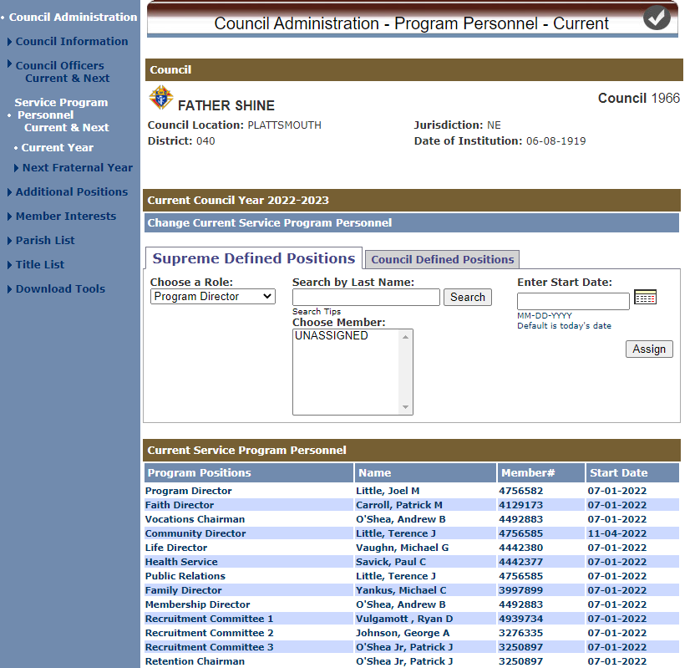
365 - Service Program Personnel
Service Personnel process work exactly the same.

Slide 7
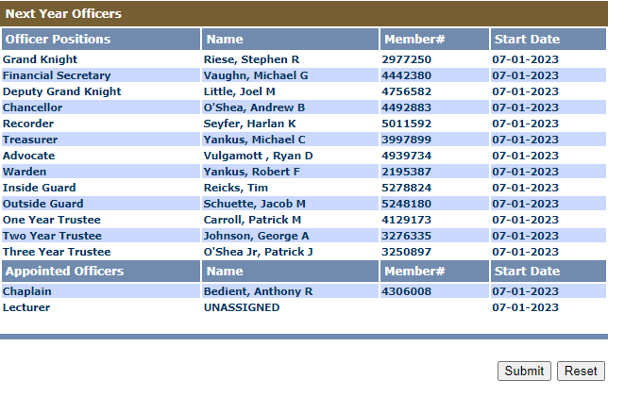
Don’t’ Forget…
Click submit for each form and it will automatically
go to Supreme and update. You do not need to mail.
Ray Guggenberger needs a copy, and you can
produce one in the print center and email to him.

Slide 8
More Info…
For Supreme training video, Click this Link:
Forms 185, 186, & 365 Online Submission Training (brightcove.net)

