Slide 1
Nebraska Knights of Columbus
2024 Membership Billing Cycle

Slide 2
Nebraska Knights of Columbus
FS/FC
This training is a random collections of thoughts from the many
questions I field concerning the annual dues assessment. I try
steering you to the right answers but I will not always succeed.
So please feel free to call me with questions or concerns.
Mike Vaughn
FS Coordination Chairman
402-297-5434

Slide 3
Before You Start…
Obtain and review the FS portion of the Leadership Resources Document
found at https://www.kofc.org/en/resources/officers/officers.pdf
Ensure you have all the supplies: membership cards (4817E), envelopes,
stamps etc.
Do you have the Council Seal?
All membership cards are required to be embossed
Affiliate Membership Initiative (AMI) is on-going
Once you have done AMI you continue it annually
Follow the Interim Billing Procedures found on page 37 of the
Leadership Resources Document

Slide 4
Annual Dues Assessment Prep Work
Determine if membership dues are appropriate
Will dues assessment meet Council administrative needs?

Slide 5
Prep Work for Dues Assessment (ConT)
If dues need to increase, approval of Council and update of by-laws
are a must. By-laws state what dues will be
Councils have some autonomy on what they charge for dues
Consider:
Forgiving dues to members in financial distress
Creating a class that reduces/eliminates dues for students, deacons,
military/first responders, etc
Reviewing disabled members and update using Form 1831

Slide 6
Generating a Dues Assessment
Generating a Dues Assessment Video
Generating a Dues Assessment - Member Management/Member Billing - Fraternal Mini Videos Video Training Gallery (bcvp0rtal.com)
Notes
Use 15 Dec as your process date
If using Assess Other, ensure previous year’s assessments are forgiven
Is the Council forgiving previously owed dues for a member?
Go to Member Ledger to credit member so balance is 0.00
Is the Council forgiving this year's dues for a member?
See Billing Information for the member to not assess

Slide 7
Nebraska Knights of Columbus
Membership Cards
Membership cards (4817E) no longer require GK or FS signatures
Will automatically print out with Supreme Knight’s signature
Print all cards after you assess dues.
Member Billing Print Center Membership Cards By Type
All Members

Slide 8
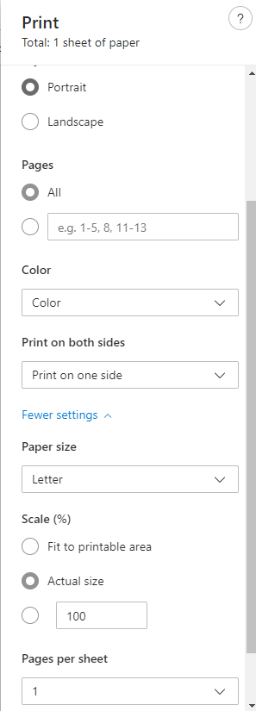
Printing Membership Cards
Done in Member Billing
Save the Downloaded PDF File to your PC and close browser
Print from the downloaded PDF file saved to your PC
Printing from Browser Can Select Wrong Scale
Ensure “Actual Size” or “100%” Scale is selected
Some Variations in Printers
Trial and Error
Always Do a Practice Run!

