Slide 1

Nebraska Knights of Columbus

Slide 2
Nebraska Knights of Columbus
Topics
Wrapping up Dues Assessment
Transferring members using on-line system
Completing forms 185/365
By-Laws
MM/MB Help section
State of Nebraska website – FS training portal

Slide 3
Wrapping up Dues Assessment
Doing Affiliate Membership Initiative (AMI)?
IAW interim billing procedures dated August 2022
Window closes on May 31st
Not AMI?
IAW the Leadership Resources document (5093)
In either case you should be wrapping up.
BTW: Buck a Month is due by end of June

Slide 4
Transferring Members using On-line System
On-Line is the preferred method
Complete as if new member
Members name must match his membership card from previous council
Name and birthday will be used to determine transfer
Form 100 is still OK
See Training Module

Slide 5
Completing Forms 185/365
Complete forms for next fraternal year
Must be done by June 30th: takes effect on 1 July
Primary notification to Supreme for council changes
Preferred method: update via Member Management
Automating system to ensure mandatory requirements (like safe environment training) and contact information is up to date
Hard copy is still OK but will eventually go away
See Training Module

Slide 6

By-Laws
Should be reviewed annually
Primary responsibility of council advocate
Sets dues for membership
Establish procedures for elections
Devolution of officers
Required committees
Establishes meeting quorum
Established audit periods

Slide 7

MM/MB Help Section
Member Management/Member Billing has a built-in help function
Contains tips, recent updates, notes, and step by step instructions
Each screen can be printed
Links to useful MB video tutorials
MM are being worked
See Training Module

Slide 8


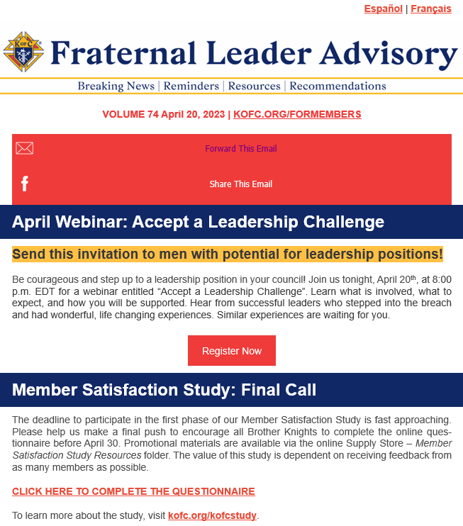



Resources
Leadership Resources Document #5093
https://www.kofc.org/en/resources/officers/officers.pdf
State of NE Website – FS training portal
https://nebraskakofc.org/resources/financial-secretary-resources.html
Fraternal Leader Advisory
https://conta.cc/40y0kbK
Signup Form (constantcontactpages.com)
Officer Desk Reference
Expert

