Slide 1
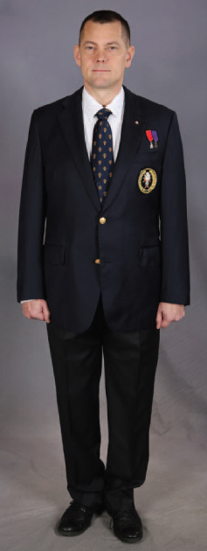
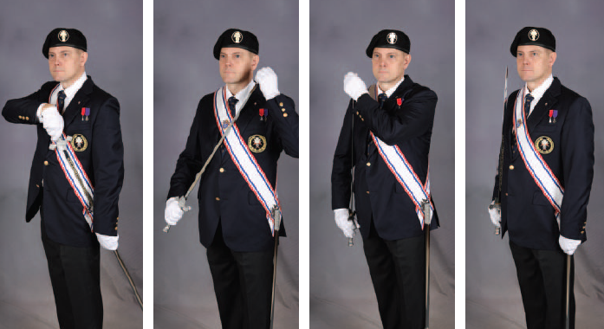
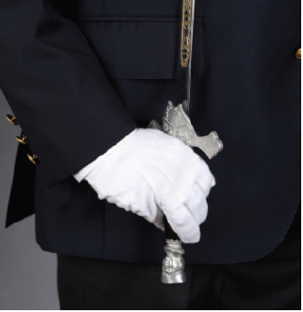
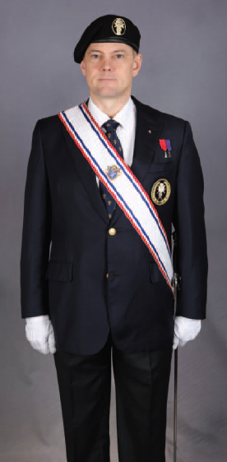
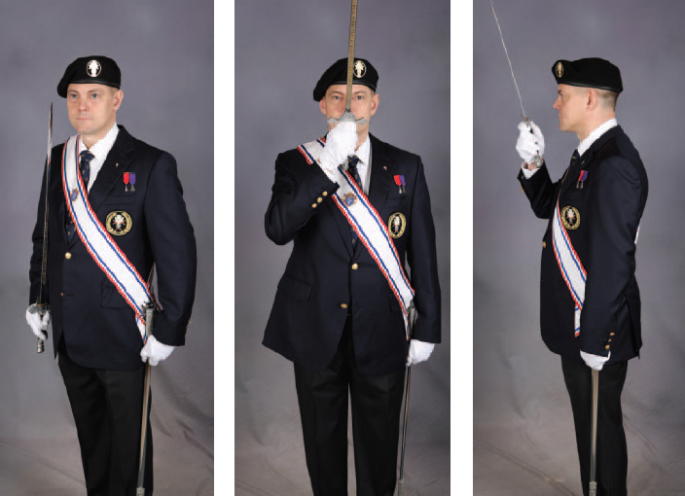
4th Degree miniature pin
and
Medals
Official Dress: Without Baldric, Sword and Beret
Carry Sword
Official Uniform Dress Color Corps
Present Sword
Salute

Slide 2
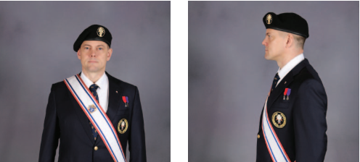
Material flat behind
medal crest
Not “Poofy” in back
Brim two
finger-width over eyebrows
Not “Puffy”
over left ear
Adjust string.
Tie off then cut inserting into the rim
Slightly overlaps
right ear
Brim should be parallel
to floor
Medal crest (Earth) directly over left eye

